Slide 1




IoT Camp preview
Gianfranco Caputo
ISMB
caputo@ismb.it
Francesco Scullino
Microsoft Innovation Center
v-frscul@microsoft.com

Slide 2
Agenda
IoT Camp introduction
Setup the environment to work with nucleo STM32
Setup the environment to work with Microsoft Azure
Microsoft Azure overview

Slide 3
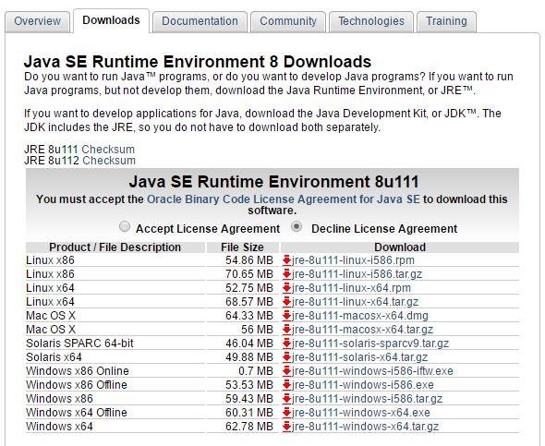
Setup the environment to work with STM32 Nucleo(I)
Download and install Java Runtime Environment http://www.oracle.com/technetwork/java/javase/downloads/index.html

Slide 4
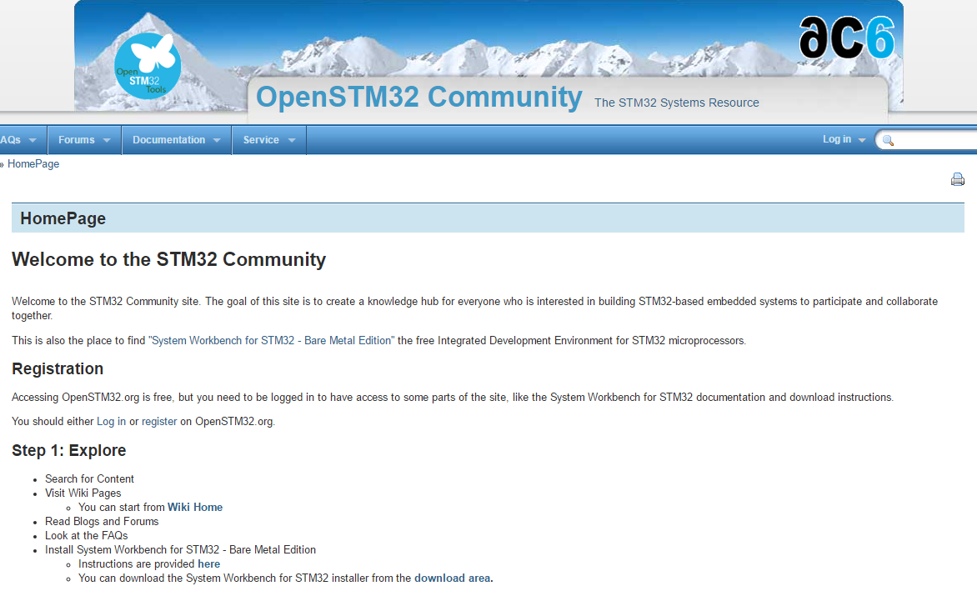
Setup the environment to work with STM32 Nucleo(II)
Download and install System Workbench for STM32 http://www.openstm32.org/HomePage

Slide 5
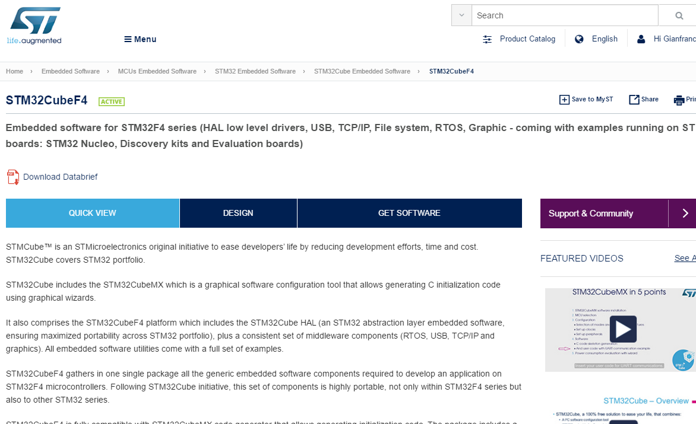
Setup the environment to work with STM32 Nucleo(III)
Download and extract STM32CubeF4 SDK http://www.st.com/en/embedded-software/stm32cubef4.html

Slide 6
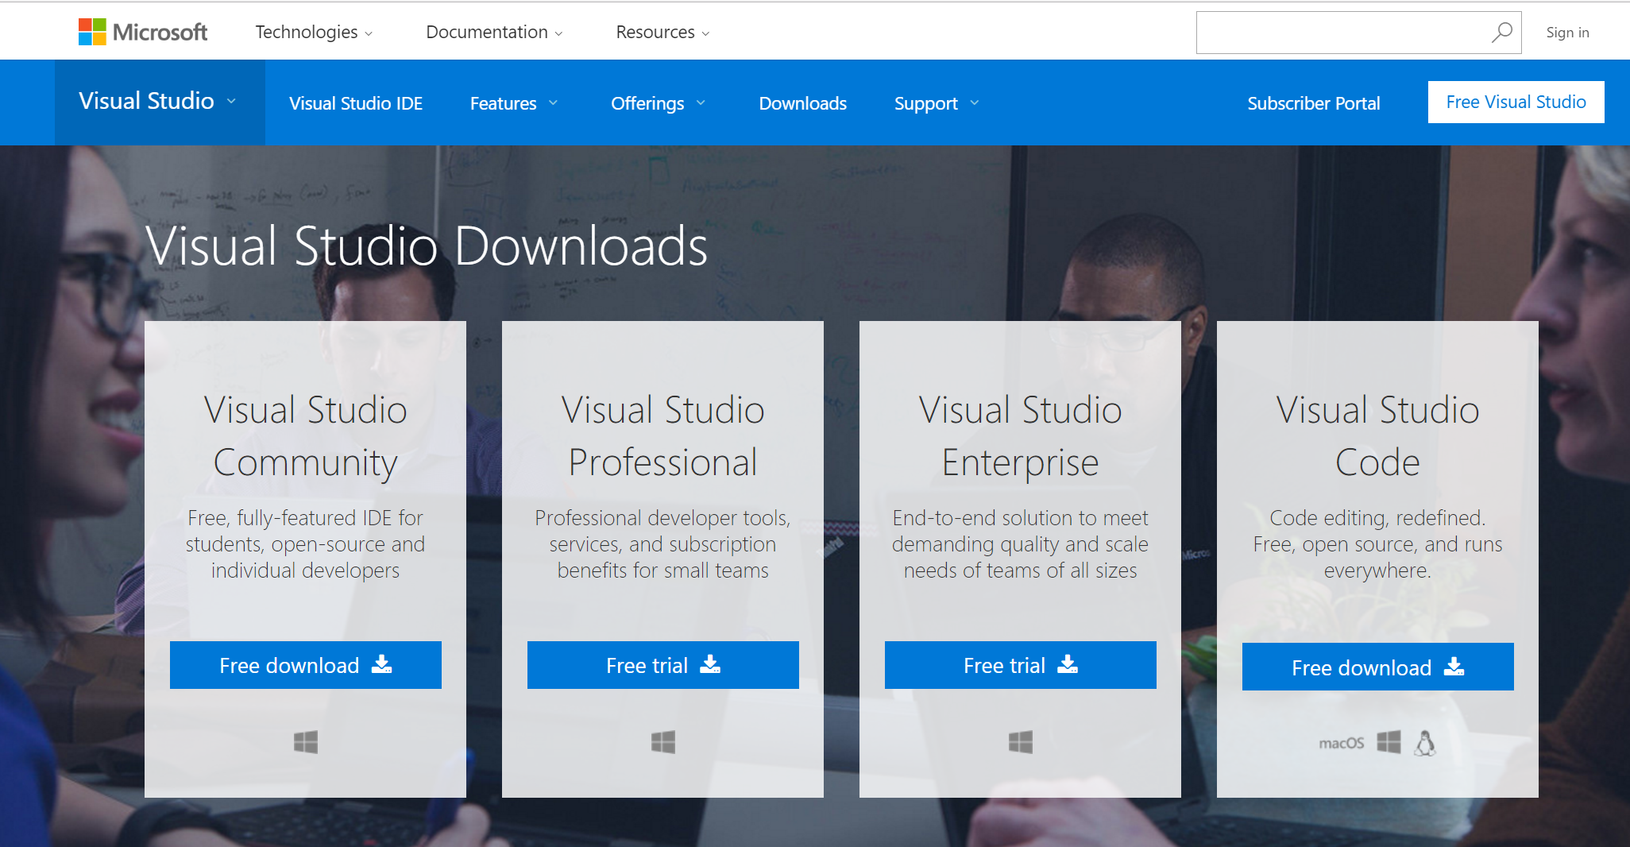
Setup the environment to work with Microsoft Azure (I)
Download and install Visual Studio 2015 https://www.visualstudio.com/downloads/

Slide 7
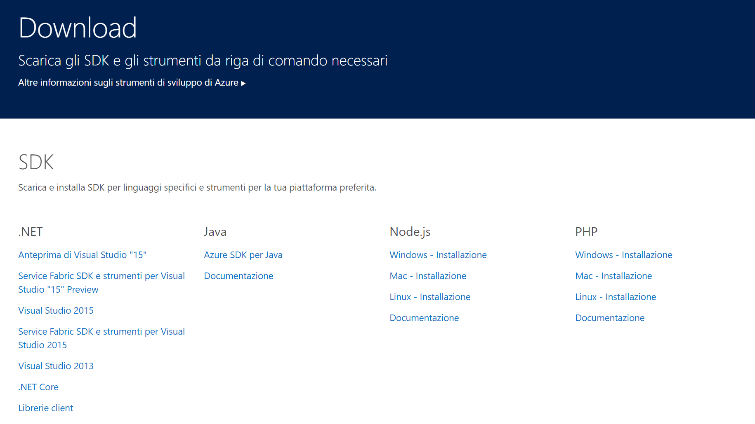
Setup the environment to work with Microsoft Azure (II)
Download and install Microsoft Azure SDK for Visual Studio 2015 https://azure.microsoft.com/it-it/downloads/

Slide 8
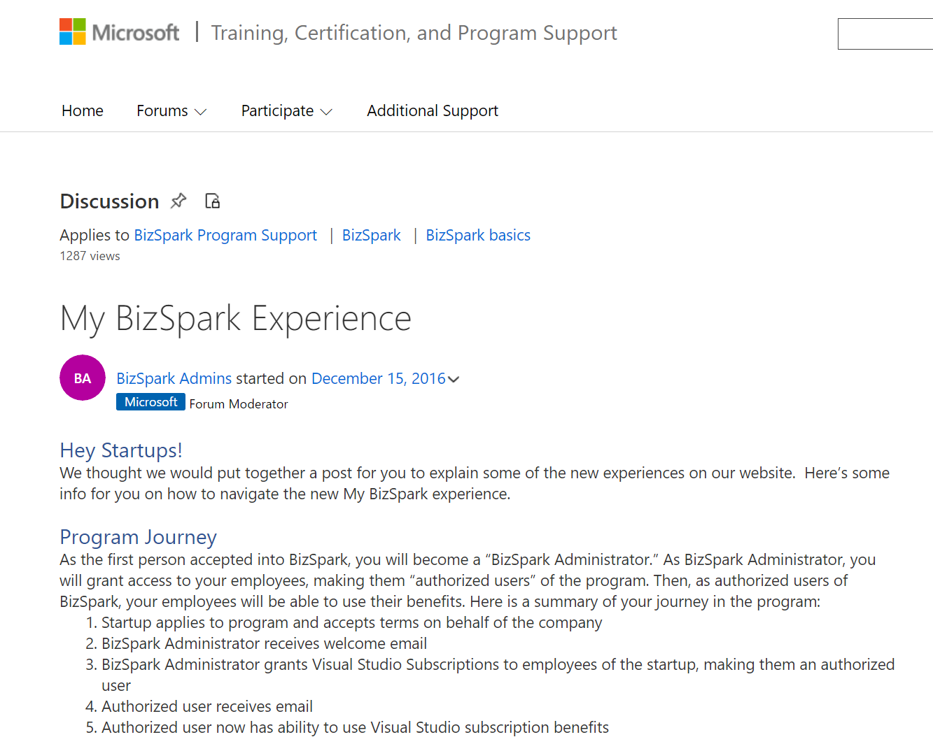
Setup the environment to work with Microsoft Azure (III)
Activate your BizSpark Microsoft Azure subscriptions https://goo.gl/dD6O4p

Slide 9
Microsoft Azure overview

Slide 10
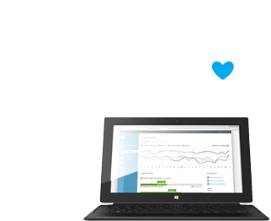
Microsoft Azure
Comprehensive set of services that enable you to quickly build, deploy and manage applications across a global network of Microsoft-managed datacenters.

Slide 11
The changing world of app development
Mainframe
Build on a developer platform (PaaS)
Monolithic
Client/Server
3 Tier
Component
RAD
Distributed
SOAP
SOA
Web
Physical Machines
Virtual Machines
Cloud Infrastructure
Born in the Cloud
REST
Mobile
Microservices
Containers
Serverless
1990
2000
2010
2016
Notes:
Il mondo dello sviluppo app è cambiato molto negli anni.
Se pensate all’inizio le applicazioni erano enormi e monolitiche, con l’avvento del web e poi dei dispositivi mobile si va sempre più verso la necessità di creare applicazioni semplici, quasi atomiche, per questo sono state introdotte tecnologie come serveless.
Per supportare questa evoluzione anche l’infrastruttura ha bisogno di essere riadattata.
Dalle machine fisiche alla virtualizzazione con l’introduzione poi di piattaforme cloud fino all’astrazione dell’infrastruttura utilizzando servizi di tipo paas.
Key talking points:
In the beginning, there were physical machines. They were expensive and developers loaded them up with multiple applications to save costs. This caused no end of conflicts and unexpected bugs, yet effective machine utilization was still low. Developers struggled to make sure changes to one application didn’t break an unrelated application.
Next up: virtual machines. Since multiple VMs could be run on a single physical box, developers installed their applications in contained VMs, which reduced conflicts and improved utilization, but welcome to shared memory and unpredictable performance. And since provisioning had to be made for the largest loads, “scaling in” wouldn’t really save money.
Enter the cloud. Companies could rent the virtual machines they needed, when they needed them. They could scale applications up and down on demand. You still needed to install and configure OS level patches and updates, and you still had to contend with low-level networking.
But most of the benefits of this model accrued to operations and infrastructure, not app development.
In a new Evans Data survey of 1,441 developers, 81.3% of respondents said they plan to build applications in the cloud within the next 24 months.

Slide 12
On Prem - IaaS – PaaS - SaaS
Hosting models
Business model
On Premises
(Private Datacenter)
Infrastructure
(as a Service)
Platform
(as a Service)
Software
(as a Service)
Applications
Applications
You manage
Applications
Applications
You scale, make resilient and manage
You scale, make
resilient & manage
Data
Data
Data
Data
Runtime
Runtime
Runtime
Runtime
Scale, resilience and management by vendor
Middleware
Middleware
Middleware
Scale, resilience and management by vendor
Middleware
O/S
O/S
O/S
O/S
Virtualization
Virtualization
Managed by vendor
Virtualization
Virtualization
Servers
Servers
Servers
Servers
Storage
Storage
Storage
Storage
Networking
Networking
Networking
Networking
Notes:
Fare esempio di e-Commerce

Slide 13


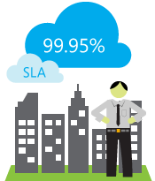
Microsoft Azure
flexible
open
solid

Slide 14
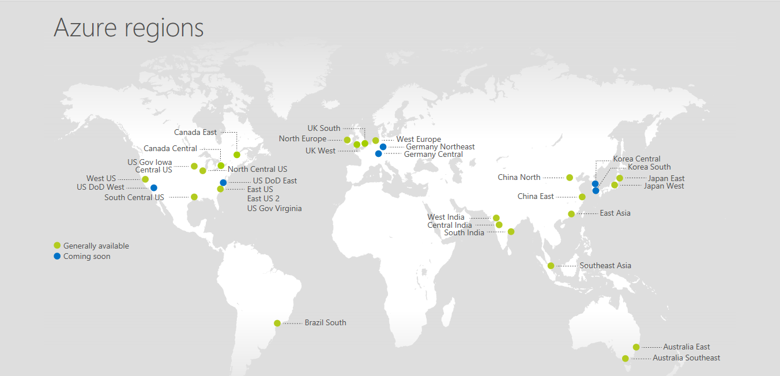
34 Regions Worldwide, 30 online… More than AWS and Google combined

Slide 15






Data services
SQL
Database
DocumentDB
Media & CDN
Data
Database as a service
Data
Warehouse
MY APP
SQL/no-SQL data stores
Developer services
Big Data capabilities
Storage
Tables
Integration
Search
Azure
Search
Caching
Data
Identity & security
Redis
Cache
Notes:
Adding Superpowers to your Apps
Once you’ve addressed the question of what is nature of your app, where will it run and what design approach you should take, you have a world of powerful Azure services at your disposal to make your app truly great.
There are more than sixty—and growing—Azure services today that you can use to develop, host, manage, support, secure, integrate, extend, and complement your application development.
Database/Data Services
Integration
Identity & Security
Developer Services
Advanced Analytics and IoT
Media & CDN
The modern developer is a solution composer, combining custom code with the best of finished services to create apps that were unimaginable not so long ago. And delivering those applications at amazing speed.

Slide 16



Developer services
Visual Studio Team Services
Azure
SDK
Team collaboration
Media & CDN
Data
Version Control
MY APP
Dev-Test Labs
Continuous integration and deployment
Integration
Developer services
Dev-Test environments
HockeyApp
Analytics & IoT
Identity & security
Application monitoring and diagnostics
App
Insights
Notes:
Adding Superpowers to your Apps
Once you’ve addressed the question of what is nature of your app, where will it run and what design approach you should take, you have a world of powerful Azure services at your disposal to make your app truly great.
There are more than sixty—and growing—Azure services today that you can use to develop, host, manage, support, secure, integrate, extend, and complement your application development.
Database/Data Services
Integration
Identity & Security
Developer Services
Advanced Analytics and IoT
Media & CDN
The modern developer is a solution composer, combining custom code with the best of finished services to create apps that were unimaginable not so long ago. And delivering those applications at amazing speed.

Slide 17

Identity & security
Azure Active
Directory
Single Sign-on
Access Control
Media & CDN
Data
User Provisioning
MY APP
Groups and distribution lists
Microsoft Graph
Integration
Developer services
Multi-Factor Authentication
Analytics & IoT
Identity & security
Anomalous sign in detection
Notes:
Adding Superpowers to your Apps
Once you’ve addressed the question of what is nature of your app, where will it run and what design approach you should take, you have a world of powerful Azure services at your disposal to make your app truly great.
There are more than sixty—and growing—Azure services today that you can use to develop, host, manage, support, secure, integrate, extend, and complement your application development.
Database/Data Services
Integration
Identity & Security
Developer Services
Advanced Analytics and IoT
Media & CDN
The modern developer is a solution composer, combining custom code with the best of finished services to create apps that were unimaginable not so long ago. And delivering those applications at amazing speed.

Slide 18





Advanced Analytics and IoT
Machine Learning
Stream Analytics
Data Factory
Media & CDN
Data
Machine Learning
Data Lake Store
MY APP
IoT for devices and data collection
Integration
Developer services
Cortana Intelligence Suite
Analytics
Cognitive Services
Cognitive Services
Analytics & IoT
Identity & security
HDInsight
IoT Hub
Notes:
Adding Superpowers to your Apps
Once you’ve addressed the question of what is nature of your app, where will it run and what design approach you should take, you have a world of powerful Azure services at your disposal to make your app truly great.
There are more than sixty—and growing—Azure services today that you can use to develop, host, manage, support, secure, integrate, extend, and complement your application development.
Database/Data Services
Integration
Identity & Security
Developer Services
Advanced Analytics and IoT
Media & CDN
The modern developer is a solution composer, combining custom code with the best of finished services to create apps that were unimaginable not so long ago. And delivering those applications at amazing speed.

Slide 19







Integration services
Logic Apps
API Apps
Media & CDN
Business process workflow
API Management
Data
MY APP
On-Premises/SaaS Connectivity
Service Bus
Integration
Developer services
Messaging
Biztalk Services
API Management
Analytics & IoT
Identity & security
Hybrid Connections
Queues
Notes:
Adding Superpowers to your Apps
Once you’ve addressed the question of what is nature of your app, where will it run and what design approach you should take, you have a world of powerful Azure services at your disposal to make your app truly great.
There are more than sixty—and growing—Azure services today that you can use to develop, host, manage, support, secure, integrate, extend, and complement your application development.
Database/Data Services
Integration
Identity & Security
Developer Services
Advanced Analytics and IoT
Media & CDN
The modern developer is a solution composer, combining custom code with the best of finished services to create apps that were unimaginable not so long ago. And delivering those applications at amazing speed.

Slide 20


Media services and content delivery network
Encoding
Indexing
Business/enterprise video
Media & CDN
Data
Content Protection
MY APP
Broadcasting
Media Player
Integration
Developer services
Media streaming
Media Analytics
Media analytics
Analytics & IoT
Identity & security
CDN from Akamai
Global content delivery
CDN from Verizon
Notes:
Adding Superpowers to your Apps
Once you’ve addressed the question of what is nature of your app, where will it run and what design approach you should take, you have a world of powerful Azure services at your disposal to make your app truly great.
There are more than sixty—and growing—Azure services today that you can use to develop, host, manage, support, secure, integrate, extend, and complement your application development.
Database/Data Services
Integration
Identity & Security
Developer Services
Advanced Analytics and IoT
Media & CDN
The modern developer is a solution composer, combining custom code with the best of finished services to create apps that were unimaginable not so long ago. And delivering those applications at amazing speed.

Slide 21







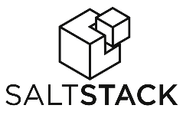












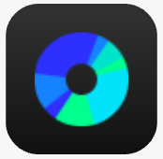

























Azure is an open cloud
DevOps
Clients
Management
Applications
PaaS &
Devops
App frameworks
and tools
Databases and
middleware
Infrastructure

Slide 22
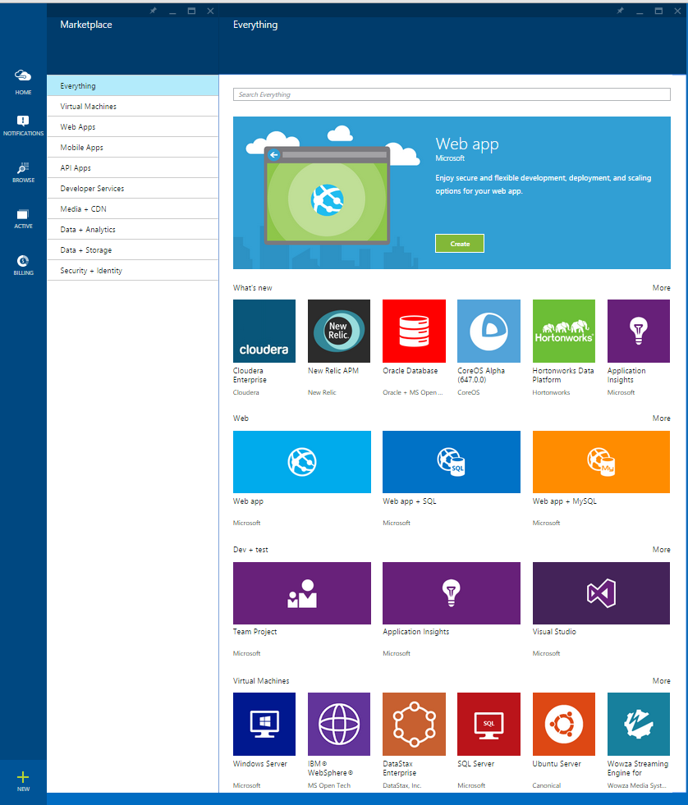
Azure Marketplace
Online store to discover, search for, and purchase integrated applications and services ready to deploy on Azure.
Growing ecosystem of 3,000+ offers
Complement and extend functionality of Azure services
One-stop shop that simplifies configuration, deployment, and management
Integrated platform experience
MARKTPLACE
Notes:
La software house può decider di far pagare una tariffa oraria oppure bring your own license (cioè il cliente acuqista la licenza dalla software house)
Azure Marketplace is the central hub on Azure for you to discover, search for, and purchase highly optimized and integrated applications and services ready to deploy on Microsoft Azure. Instead of starting with a web search, or contacting a reseller or consultant to figure out if there is an application or service that meets your needs, you can go to the Azure Marketplace and discover if there is an offering that addresses your requirements and works with solutions you’re already running on Azure.
Growing ecosystem: Marketplace is consistently adding new services (VMs and non-VM assets), expanding our portfolio of offers available to customers on Azure.
Complement and extend functionality of the Azure platform: Azure Marketplace offers choice and flexibility while strengthening Azure services. This increases the business value of the platform and makes it easier for customers to be more productive and get more done using Azure.
One-stop shop: central hub and single location for customers to easily search, purchase, configure, and create scalable deployments of applications and services that can easily integrate with existing solutions. This reduces the traditional challenges and hassle of setting up software.
Integrated platform experience: Azure Marketplace offers are managed just like Azure services in the management portal. This simplifies application management and makes it easier for customers to build applications and/or run their business on Microsoft Azure.

Slide 23

Microsoft Azure Web Apps

Slide 24
Full capability set available including:
.NET, Node.js, Java, PHP, and Python
WebJobs for long running tasks
Integrated VS publish, remote debug…
CI with GitHub, BitBucket, VSO
Auto-load balance, Autoscale, Geo DR
Virtual networking and hybrid connections
Site slots for staged deployments
Web Apps
Web apps run as-is
no changes required

Slide 25
Demo

Slide 26
Q & A

Slide 27
Keep in touch bizitbus@microsoft.com

